Slide 1

Switch case
Lecturer
Rokas Slaboševičius

Slide 2
Today you will learn
Switch case
Switch case
01

Slide 3
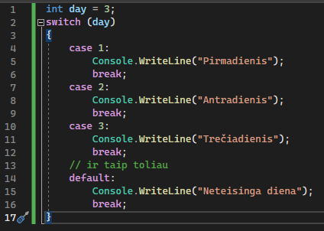
What is a switch?
Switch case
A switch is a programming construct that allows a program to perform different actions depending on the value of a variable. It is an alternative to the if and else if statement sequence. A switch statement works by first comparing the expression in the switch brackets with each case expression. When a match is found, the instructions in that case statement are executed.

Slide 4
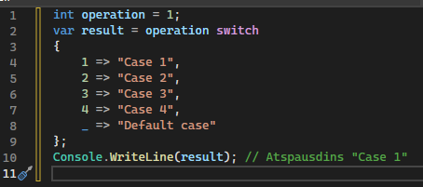
What is a switch?
Switch case
The C# language supports switch expressions from version 8.0 onwards, which are very useful for simplifying the syntax and making the code clearer. Here is what your code looks like:
Switch expression defines what to return depending on a particular
variable values. The variable operation is tested with
in each case, and if it qualifies, the corresponding
Result. The _ symbol is used as the default case,
if no other case qualifies.

Slide 5
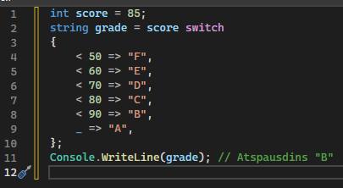
What is a switch?
Switch case
This expression is very convenient to use when you need to assign a value to a variable depending on another value.
For example, in this code snippet:
The Switch expression is used for,
to be assigned to the score entered
appropriate grade.
Note that Pattern Matching is also used here with switch expressions, where case can be not only specific values but also frames of values.

Slide 6

Switch case
Task 1
Create a program that reads the customer's day of the week input (numbers) and prints its name.
Create an app that allows users to enter their age. Depending on the age, the application should print a message such as "Student" (if age 7 to 18), "Student" (if age 19 to 25), "Employee" (if age 26 to 65) and "Retired" (if age 66 or older).
Create a program that gets the month number and prints the month name.

Slide 7
Switch case
Task 2
Create a program that allows the user to enter the name of one of four different shapes - square, circle, triangle, rectangle - and then, depending on the chosen shape, asks for the required parameters (e.g. the side of a square, the radius of a circle, the height and base of a triangle or the length and width of a rectangle). The program should calculate and print the area of the selected figure.
Create an app that allows the user to choose one of the five basic elements: fire, water, air, earth, ether. Based on the element selected, the program should print a property or characteristic specific to the element.
Create an app that allows the user to choose one of four university majors: maths, computer science, biology, chemistry. Then, based on the chosen major, ask the user to enter his/her grade point average, exam results and other relevant data. The application should calculate and print out the user's chances of gaining admission to the chosen specialty (you can improvise what "chance" means).

Slide 8
Switch case
Task 3
Create an app that accepts the month number entered by the user and prints whether it is spring, summer, autumn or winter.
Create a program that allows the user to select six different mathematical operations that can be performed on two numbers (e.g. addition, subtraction, multiplication, division, squaring, root pulling) and prints the corresponding result.
Create a program that reads the currency (USD, EUR, GBP, JPY) and amount entered by the user. The program should print the amount converted into the other three currencies at certain fixed exchange rates.

